Slide 1
MeetCute;)
Week 1 Review

Slide 2
Agenda
What is MeetCute?
Meet The Team!
Review: Week One
Who are our competitors?
What is Meteor.js?
Project Requirements
Management Plan
QA plan
Any questions?
Notes:
What is MeetCute? - AN
Meet The Team! - AN
Review: Week One - AN
Who are our competitors? - DS
What is Meteor.js? - DS
Project Requirements - BB
Management Plan - GL
QA plan - Bella
Any questions?

Slide 3
Project Summary
Project Name: MeetCute
“A dating website for the modern era”
Goals:
Appeal to singles on the go, looking for a fast & easy way to date, while also providing security.
Learn responsive technologies & security around them

Slide 4
Meet The Team!
Team Leader: Daniel
QA Leader: Ian, Bella
Security Leader: Gabriel
Configuration Leader: Gautam
Integration/Environment Leader: Becky
Design Leader: Adiba
Requirement Leader: Bella

Slide 5
Review: Week 1
Team Objectives: Ramp up on Meteor!
Installation & Tutorials
Establish Github Repo
Complete SPPP
Whiteboard dating site & page flow
Assign tasks
Start to pair program!

Slide 6
Related Work - Competitors
 | MeetCute (us) | OkCupid
Application Type | Responsive Web App for all browsers. | Non-Responsive Web App IOS& Android App
Client side framework | React.js | React.js / native app
Server side framework | Node.js (JavaScript) Runs fast. Easier to implement. | OKWS (C++) Runs a little faster, but harder to implement.
Database | MongoDB (NoSQL) Scalable, easy to use, but not as mutual as SQL. | SQL More mature and stable.
Architectural Pattern | MVC (bound by Meteor.js) | MVC
Product Design | Responsive,Single-page, Latency Compensation | X

Slide 7
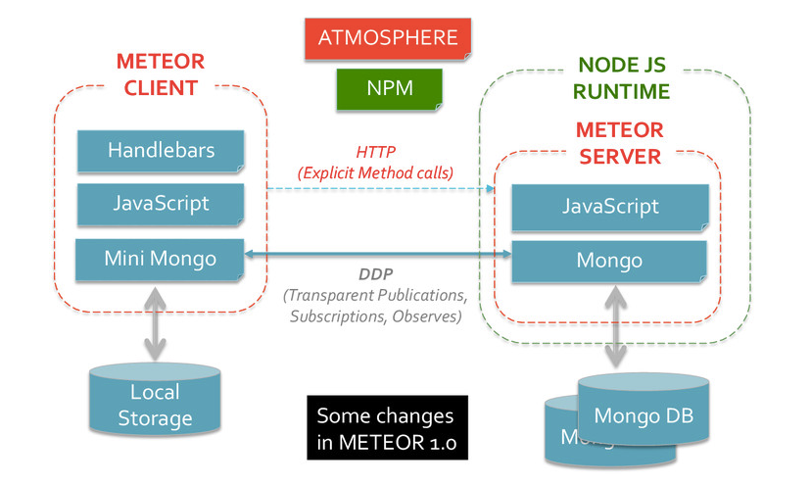
Technology: Meteor
We chose this technology because it is easy to proof of concept applications while at the same time being able to be run in production.

Slide 8
MeetCute - Requirements
Features:
Account sign-up, log in and log out
A user Profile page and ability to edit or delete Profile
“Discover:” a gallery view of other user Profiles
Chat functionality between users
Nice to haves:
Log in with Facebook
Ability to set Profiles as Favorites
Keyword search for Profiles with similar interests
Optimized for mobile view
Nonfunctional concerns:
Security of storage user data
No access to site or data for non-users
Performance optimizations
Caching

Slide 9



Management Plan
Process Model: “Agile”
Risks:
Technologies/Frameworks/Tools - New (to us)
Meteor, MongoDB, GIT
Risk level: Low
Reasoning: Paired Programming & Tutorials
Large Team w/ varying schedules
Risk: Low
Reasoning: Slack, Remote Web dial in (Skype)

Slide 10
MeetCute - Quality Assurance Plan
Metrics:
(1) products metrics
(2) process metrics.
Standards:
(1) documents standards
(2) coding standards.
Inspection/review process - (what / when/ who / how).
Testing - (when / who / what type / how).
Defect management - the criteria of defect.

Slide 11
Appendix
Meteor: https://www.gravitywell.co.uk/latest/how-to/posts/meteor-bring-the-awesome-part-0/

